Slide 1


Project Snake & Ladder
on Scala Programming Language
Create by
Prayogo Cendra (2014730033)
Melinda Nur Abianti (2014730012)
Gabriella(2014730013)
Betari(2014730030)
Kresna(2014730048)

Slide 2
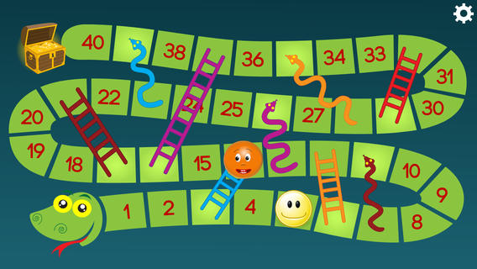
Snake & Ladder ?
Ular tangga adalah permainan papan untuk anak-anak yang dimainkan oleh 2 orang
Setiap pemain mulai dengan bidaknya di kotak pertama
Pemenang adalah pemain pertama yang mencapai kotak terakhir.
Aturan :
Pemain mengocok dadu secara bergantian.
Pemain mendapat giliran kocok dadu lagi, bila ia mendapatkan angka 6 dari dadu
Bila pemain menduduki kotak kepala ular, ia akan turun ke kotak yang memiliki ekor ular yang sama
Jika ia menduduki kotak tangga, ia akan naik sampai ke ujung tangga di atas.

Slide 3
Langkah Bermain Ular Tangga
Dengan menggunakan Text Mode Scala
1. Pilih Mode Permainan
ULAR TANGGA
1. Player versus Player
2. Player versus Computer
Option :

Slide 4
Langkah Bermain Ular Tangga(2)
2. Pilih Mode Permainan
ULAR TANGGA
1. Player versus Player
2. Player versus Computer
Option : 1
Player 1 name : Stuart
Player 2 name : Dave

Slide 5
Langkah Bermain Ular Tangga(3)
3. Tiap pemain mendapat giliran bermain.
|100- | 99- | 98- | 97- | 96- | 95- | 94-66 | 93- | 92- | 91-72 |
| 81- | 82- | 83- | 84- | 85- | 86- | 87- | 88- | 89- | 90- |
| 80- | 79- | 78- | 77-93 | 76- | 75-34 | 74- | 73- | 72- | 71- |
| 61- | 62- | 63- | 64-99 | 65- | 66- | 67- | 68- | 69-24 | 70- |
| 60- | 59- | 58- | 57- | 56-42 | 55-19 | 54- | 53-62 | 52-30 | 51-70 |
| 41-25 | 42- | 43- | 44- | 45- | 46- | 47- | 48- | 49- | 50- |
| 40- | 39- | 38-3 | 37- | 36- | 35- | 34- | 33-84 | 32- | 31-71 |
| 21- | 22-9 | 23- | 24- | 25- | 26- | 27- | 28- | 29- | 30- |
| 20-89 | 19- | 18- | 17- | 16- | 15- | 14- | 13- | 12-35 | 11- |
| 1- | 2- | 3-78 | 4- | 5- | 6- | 7- | 8-16 | 9- | 10- |
Stuart's position : 0
Dave's position : 0
Now is Stuart's turn! Press enter to play...

Slide 6
Langkah Bermain Ular Tangga(4)
4. Cara Baca Peta Game Ular Tangga
|100- | 99- | 98- | 97- | 96- | 95- | 94-66 | 93- | 92- | 91-72 |
| 81- | 82- | 83- | 84- | 85- | 86- | 87- | 88- | 89- | 90- |
| 80- | 79- | 78- | 77-93 | 76- | 75-34 | 74- | 73- | 72- | 71- |
| 61- | 62- | 63- | 64-99 | 65- | 66- | 67- | 68- | 69-24 | 70- |
| 60- | 59- | 58- | 57- | 56-42 | 55-19 | 54- | 53-62 | 52-30 | 51-70 |
| 41-25 | 42- | 43- | 44- | 45- | 46- | 47- | 48- | 49- | 50- |
| 40- | 39- | 38-3 | 37- | 36- | 35- | 34- | 33-84 | 32- | 31-71 |
| 21- | 22-9 | 23- | 24- | 25- | 26- | 27- | 28- | 29- | 30- |
| 20-89 | 19- | 18- | 17- | 16- | 15- | 14- | 13- | 12-35 | 11- |
| 1- | 2- | 3-78 | 4- | 5- | 6- | 7- | 8-16 | 9- | 10- |
Peta terdiri dari 100 kotak posisi
Ular dan Tangga terbentuk secara random
Terdapat total 20 Ular dan Tangga setiap model peta

Slide 7
Langkah Bermain Ular Tangga(5)
5. Pemain dapat mendapatkan posisi Kotak berisi Ular
|100- | 99- | 98- | 97- | 96- | 95- | 94-66 | 93- | 92- | 91-72 |
| 81- | 82- | 83- | 84- | 85- | 86- | 87- | 88- | 89- | 90- |
| 80- | 79- | 78- | 77-93 | 76- | 75-34 | 74- | 73- | 72- | 71- |
| 61- | 62- | 63- | 64-99 | 65- | 66- | 67- | 68- | 69-24 | 70- |
| 60- | 59- | 58- | 57- | 56-42 | 55-19 | 54- | 53-62 | 52-30 | 51-70 |
| 41-25 | 42- | 43- | 44- | 45- | 46- | 47- | 48- | 49- | 50- |
| 40- | 39- | 38-3 | 37- | 36- | 35- | 34- | 33-84 | 32- | 31-71 |
| 21- | 22-9 | 23- | 24- | 25- | 26- | 27- | 28- | 29- | 30- |
| 20-89 | 19- | 18- | 17- | 16- | 15- | 14- | 13- | 12-35 | 11- |
| 1- | 2- | 3-78 | 4- | 5- | 6- | 7- | 8-16 | 9- | 10- |
Dice roll 3
Stuart move from 83 to 86
Awww, Stuart found a snake to 38
Stuart's position : 38
Dave's position : 58

Slide 8
Langkah Bermain Ular Tangga(6)
6. Pemain dapat mendapatkan posisi Kotak berisi Tangga
|100- | 99- | 98- | 97- | 96- | 95- | 94-66 | 93- | 92- | 91-72 |
| 81- | 82- | 83- | 84- | 85- | 86- | 87- | 88- | 89- | 90- |
| 80- | 79- | 78- | 77-93 | 76- | 75-34 | 74- | 73- | 72- | 71- |
| 61- | 62- | 63- | 64-99 | 65- | 66- | 67- | 68- | 69-24 | 70- |
| 60- | 59- | 58- | 57- | 56-42 | 55-19 | 54- | 53-62 | 52-30 | 51-70 |
| 41-25 | 42- | 43- | 44- | 45- | 46- | 47- | 48- | 49- | 50- |
| 40- | 39- | 38-3 | 37- | 36- | 35- | 34- | 33-84 | 32- | 31-71 |
| 21- | 22-9 | 23- | 24- | 25- | 26- | 27- | 28- | 29- | 30- |
| 20-89 | 19- | 18- | 17- | 16- | 15- | 14- | 13- | 12-35 | 11- |
| 1- | 2- | 3-78 | 4- | 5- | 6- | 7- | 8-16 | 9- | 10- |
Dice roll 2
Stuart move from 1 to 3
Yaay, Stuart found a ladder to 36
Stuart's position : 36
Dave's position : 1

Slide 9
Langkah Bermain Ular Tangga(7)
7. Pemain memenangkan permainan saat mencapai Kotak ke-100
|100- | 99- | 98- | 97- | 96- | 95- | 94-66 | 93- | 92- | 91-72 |
| 81- | 82- | 83- | 84- | 85- | 86- | 87- | 88- | 89- | 90- |
| 80- | 79- | 78- | 77-93 | 76- | 75-34 | 74- | 73- | 72- | 71- |
| 61- | 62- | 63- | 64-99 | 65- | 66- | 67- | 68- | 69-24 | 70- |
| 60- | 59- | 58- | 57- | 56-42 | 55-19 | 54- | 53-62 | 52-30 | 51-70 |
| 41-25 | 42- | 43- | 44- | 45- | 46- | 47- | 48- | 49- | 50- |
| 40- | 39- | 38-3 | 37- | 36- | 35- | 34- | 33-84 | 32- | 31-71 |
| 21- | 22-9 | 23- | 24- | 25- | 26- | 27- | 28- | 29- | 30- |
| 20-89 | 19- | 18- | 17- | 16- | 15- | 14- | 13- | 12-35 | 11- |
| 1- | 2- | 3-78 | 4- | 5- | 6- | 7- | 8-16 | 9- | 10- |
Dice roll 5
Dave move from 95 to 100
Stuart's position : 42
Dave's position : 100
CONGRATULATION!!!
Dave is the winner!

Slide 10

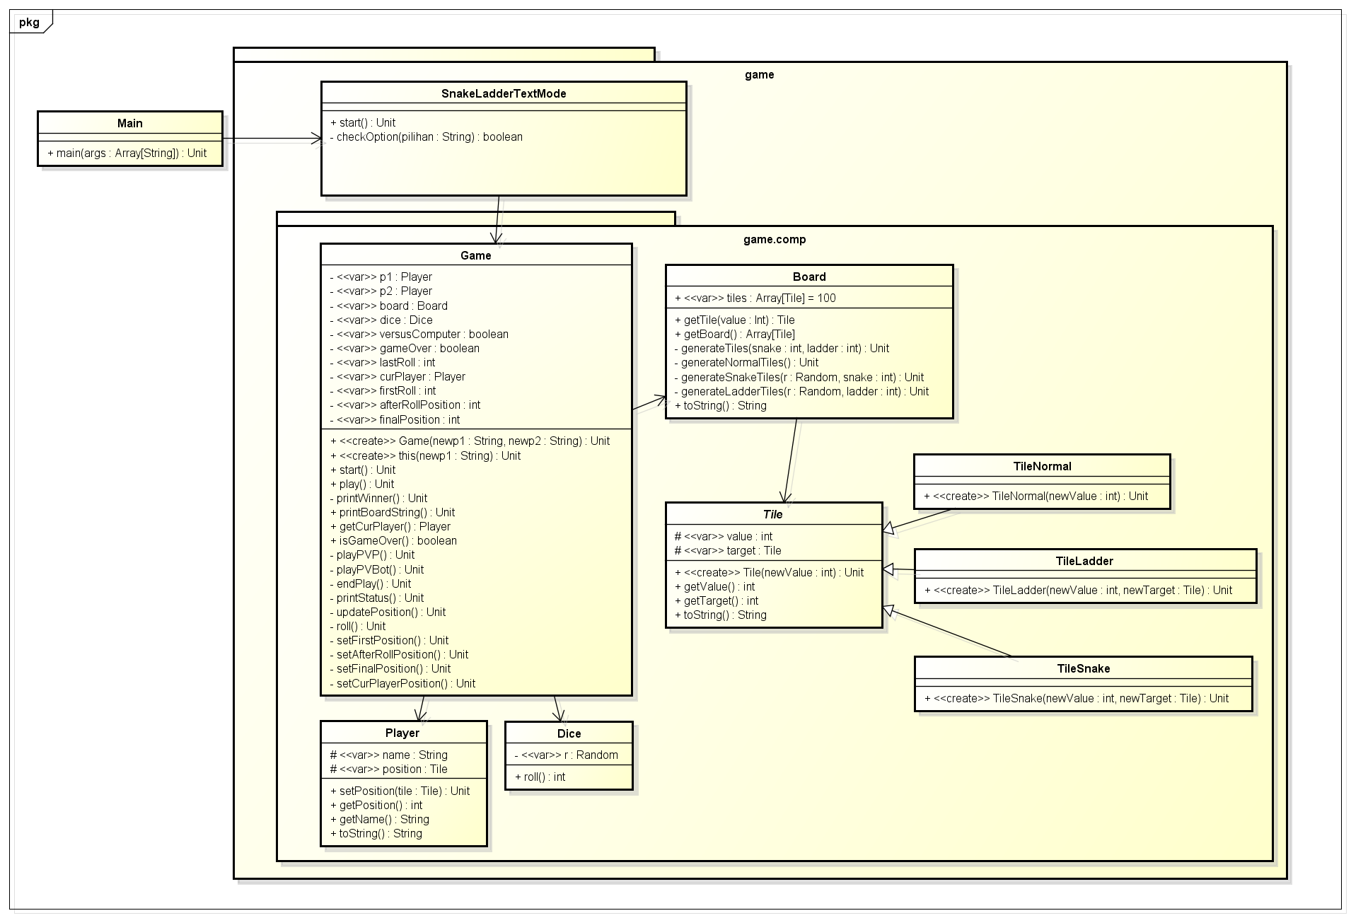
Project Snake & Ladder
Class Diagram

Slide 11
Snake & Ladder

Slide 12
Snake & Ladder game.comp
Kelas Tile : Kelas Abstract representasi dari kotak dalam peta permainan
TileNormal : Tile yang tidak mempunyai sifat
TileLadder : Tile yang memiliki Tangga
TileSnake : Tile yang memiliki Ular

Slide 13
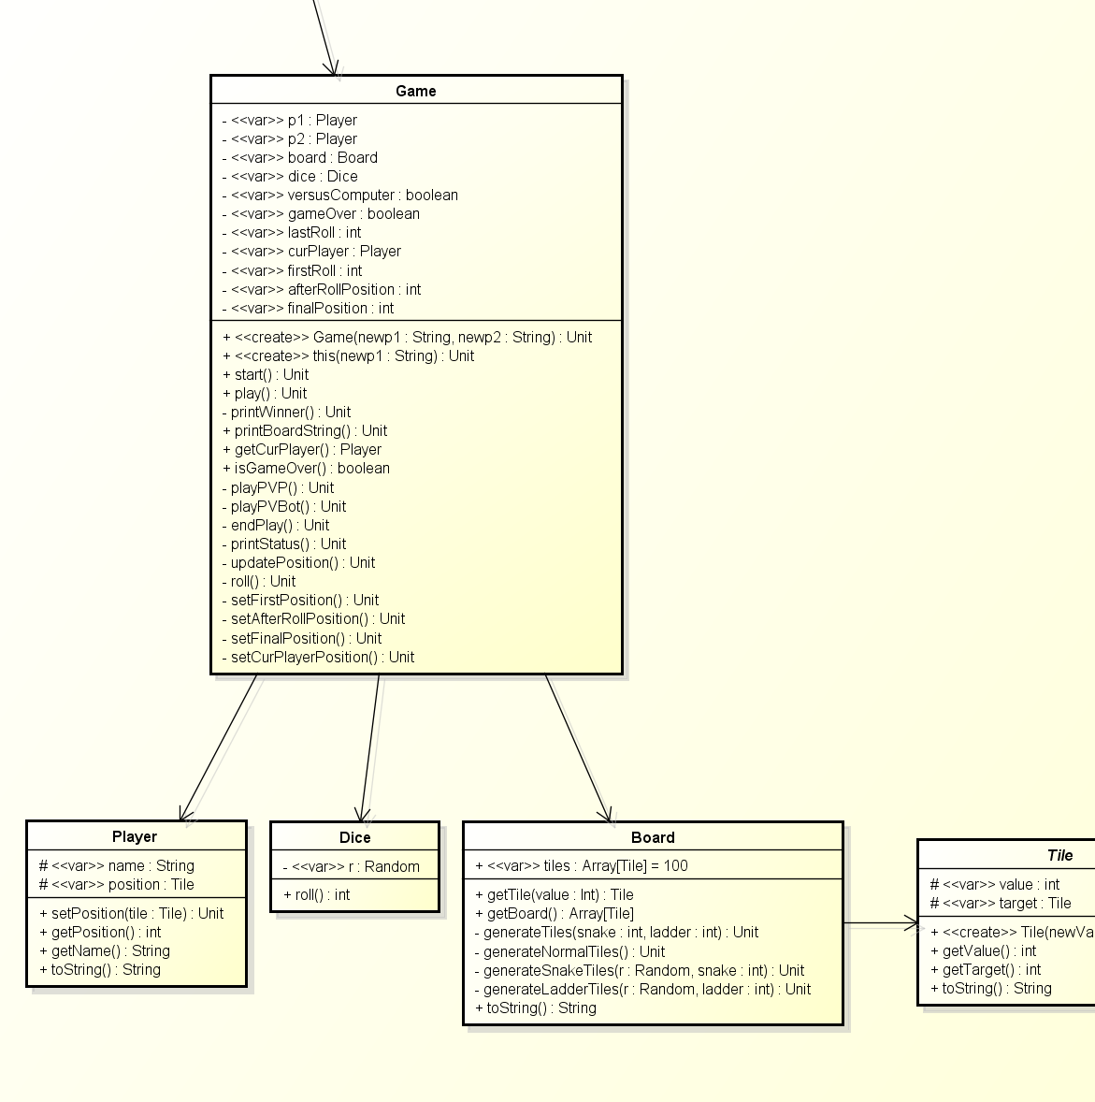
Snake & Ladder game.comp
Kelas Game : Kelas pemroses permainan
Kelas Player : Kelas untuk pemain game Ular Tangga
Kelas Dice : Kelas untuk dadu permainan
Kelas Board : Kelas papan permainan. Kelas ini menggunakan Array bertipe data Tile sebagai atribut

Slide 14
Snake & Ladder Main
Kelas SnakeLadderTextMode
Kelas yang dipanggil oleh Main Untuk mencegah kesalahan input dari keyboard.

Slide 15


Slide 16
Thank you!
Universitas Katolik Parahyangan
Bandung
2015

